Slide 1
Hybrid Techniques for Knowledge-based NLP (HybridNLP) knowledge graphs meet machine learning and all their friends
José Manuel Gómez Pérez & Ronald Denaux
ISWC 2018 – Monterey, Oct. 8th 2018
Notes:
By the way, these are the only slides you are seeing today!

Slide 2
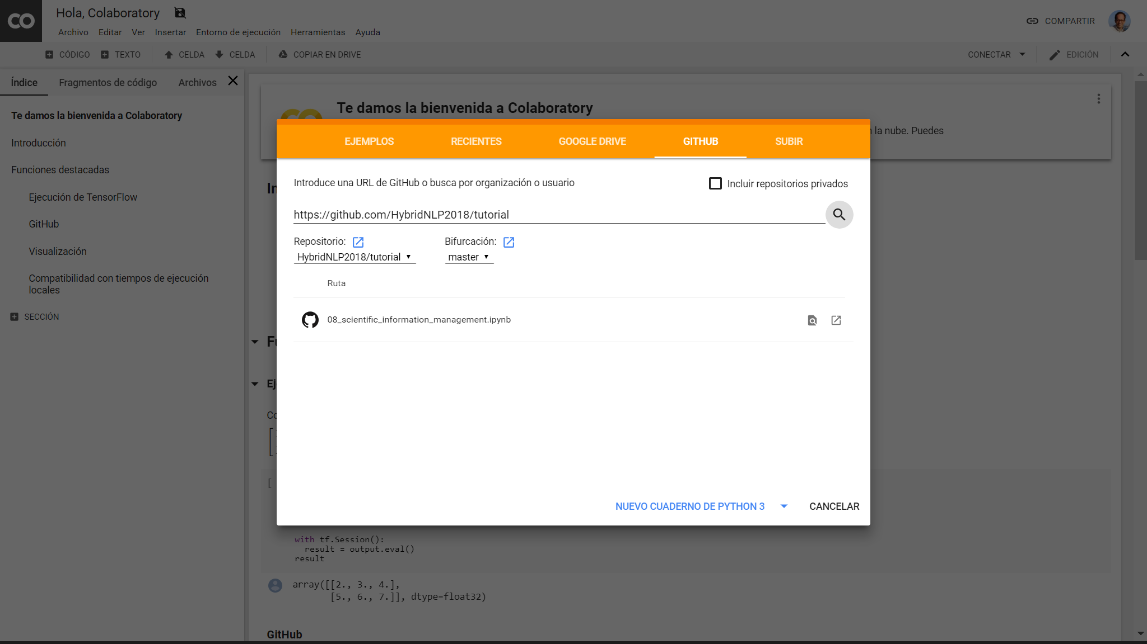
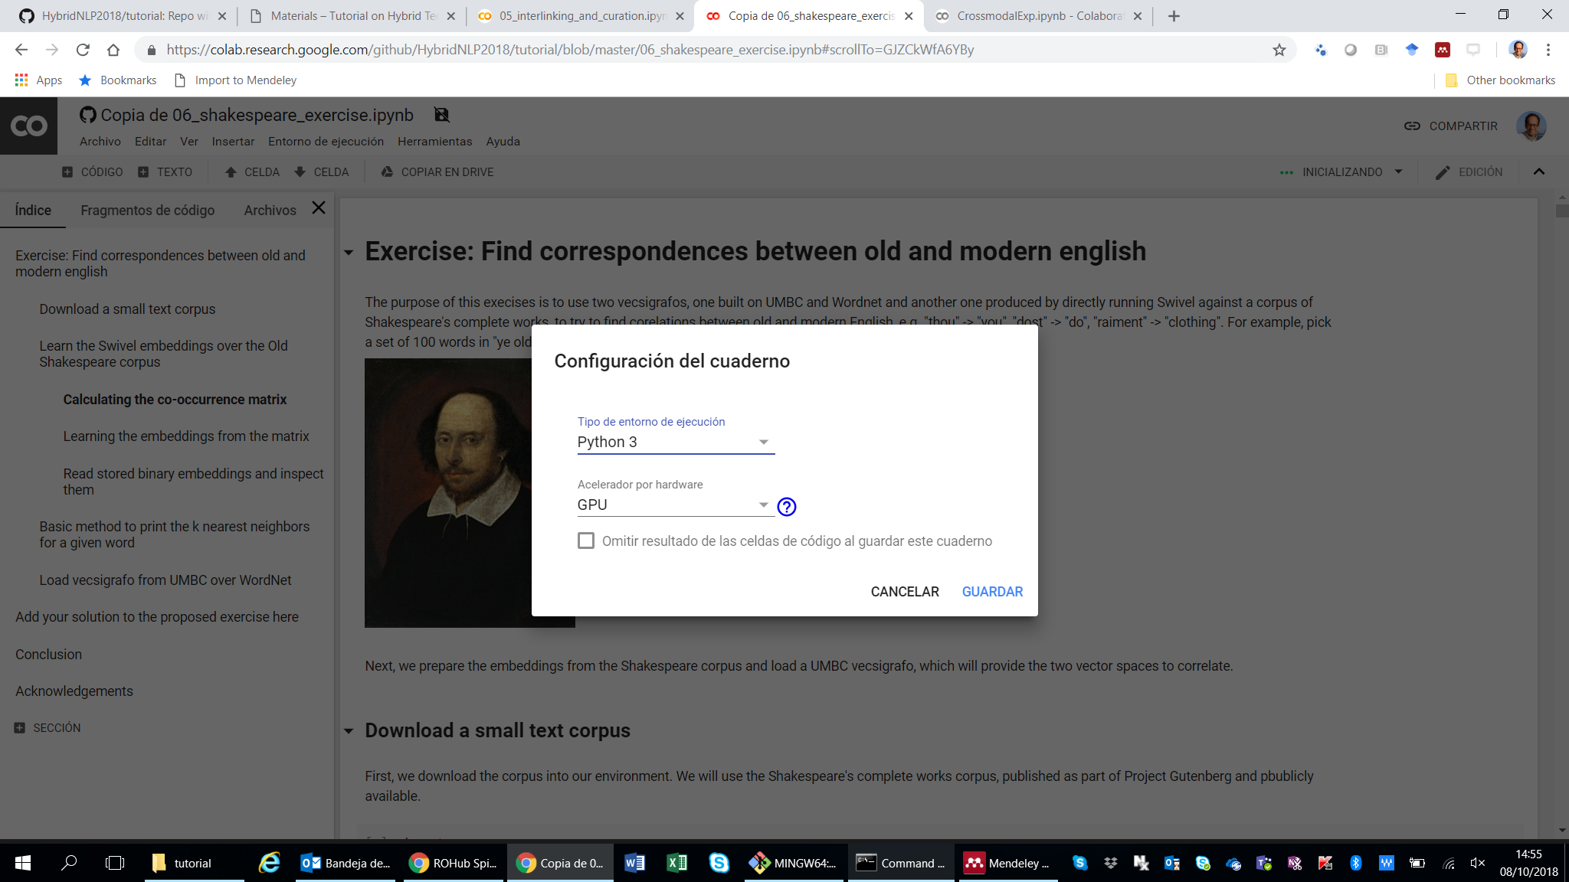
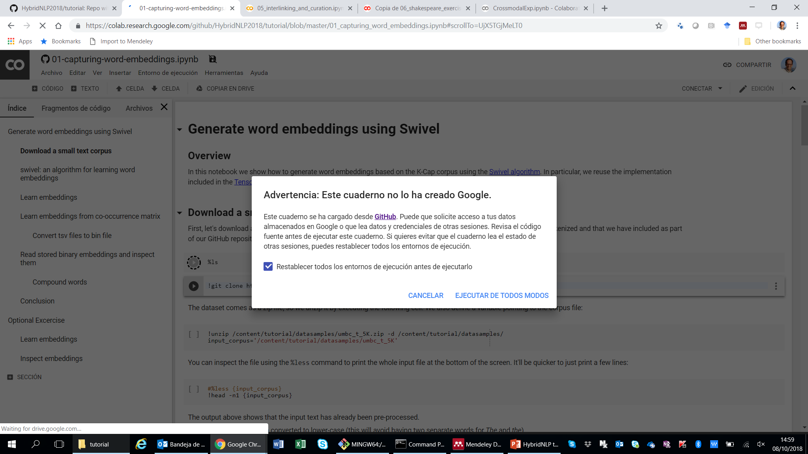
Before we start!
If you have not done so yet:
Sign in to your Google account and go to “Hello, Colaboratory”: https://colab.research.google.com
Use the GUI to download the tutorial notebooks from the tutorial repo on GitHub: https://github.com/HybridNLP2018/tutorial
Contributions welcome via pull request
Open the notebooks
Warning: Some of the notebooks (e.g. notebook 08) may take a while to load data and/or model weights

Slide 3
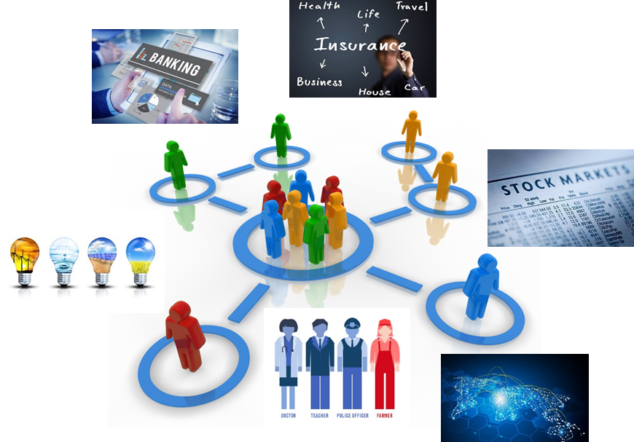

AI and the Data Deluge
Urgent need of extending human decision-making capabilities to cope with data, understanding text, images or driving cars
AI becoming an integral part of our day-to-day lives, helping doctors, teachers and financial advisors, and sometimes replacing them
“By 2020 the digital universe will turn 35 Zb (90% unstructured data, 70% user-generated)”
Notes:
The size of the digital universe will turn 35 Zetabytes by 2020
90% unstructured data
70% user-generated
75% data derivation
1.5% only high-value data

Slide 4



The 2008 Financial Crisis
Notes:
I would like to illustrate this gap with a real example from the financial domain: the 2008 crisis an what is going on since then.

Slide 5

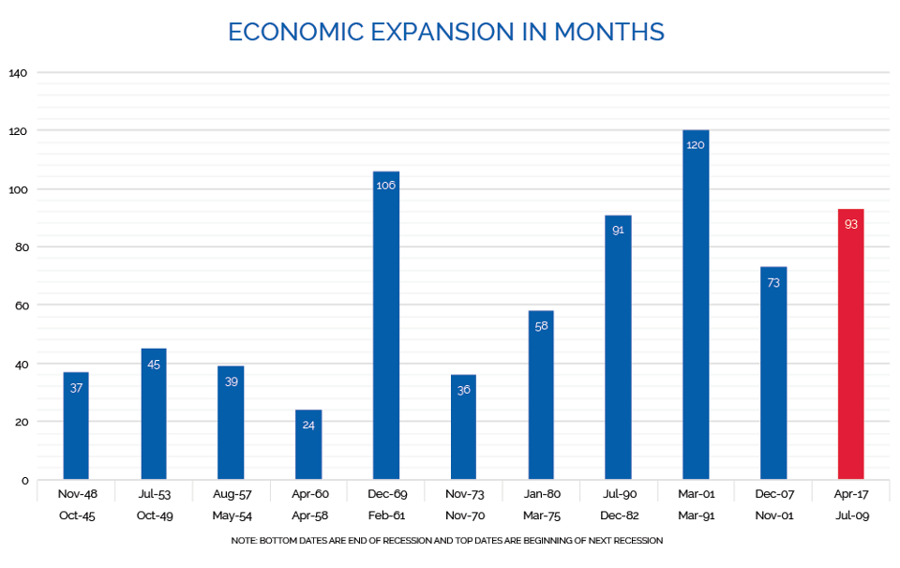
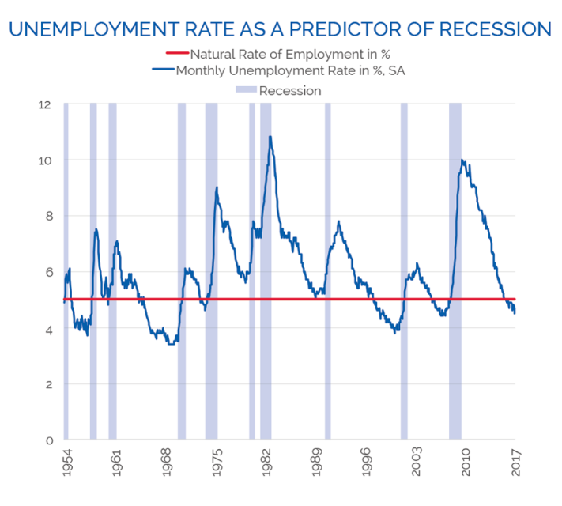
Is Another Recession Coming?
[..] the length of the current recovery – 93 months as of April 2017 – is the third longest of the 11 expansion periods since the end of World War II. Should the recovery last past May 2018, it would surpass the 106-month expansion of 1961-1969. It would match the longest period, 120 months, in July 2019. Looking simply at the cycle, one could say the due date is near.
[..] when the unemployment rate falls below 5% [..] a recession usually follows within the next two or three years. For example, the unemployment rate started sinking below 5% in December 2005, and the Great Recession started in January 2008 — 25 months later.
Notes:
https://www.forbes.com/sites/axiometrics/2017/04/21/is-a-recession-coming/#2ea508ad6103

Slide 6
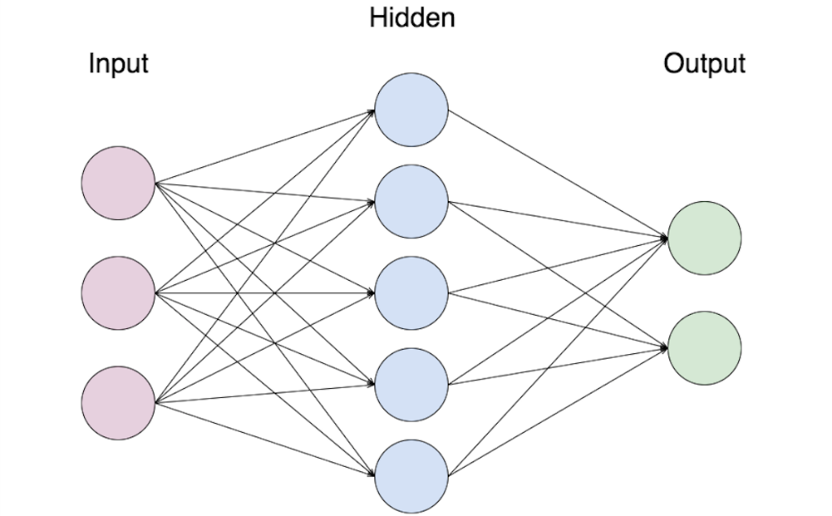
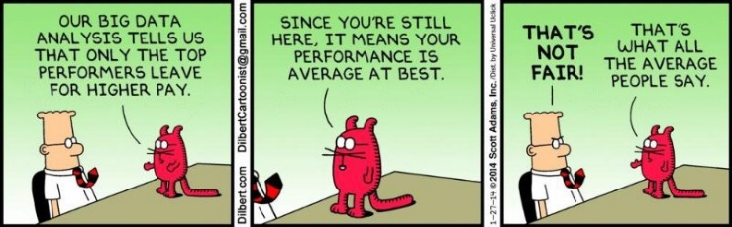
The statistical approach
Is Another Recession Coming?
Big Data
Unemployment
yes
Economic expansion
no
Housing market
GPUs
Prediction
Recession
Powerful and cheap if meaningful data abounds (otherwise, curating a corpus is costly)
Brittle and biased depending on the corpus
Statistic induction, not (logically) explainable
Humans seek meaning and causal explanation
Inspired on Ferrucci, 2016

Slide 7

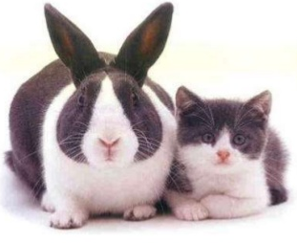

But, how important can reproducibility and justification be?
47 of 53 landmark publications in cancer research could not be replicated
Notes:
In addition to finance I’m wroking in other domain where logical justification and explanation are actually key. Explanation is indeed important, amongst other things for reproducibility in scientific research. How to achieve it? For example, encapsulating scientific investigations in objects which contain all the necessary knowledge to automatically reproduce scientific claims

Slide 8

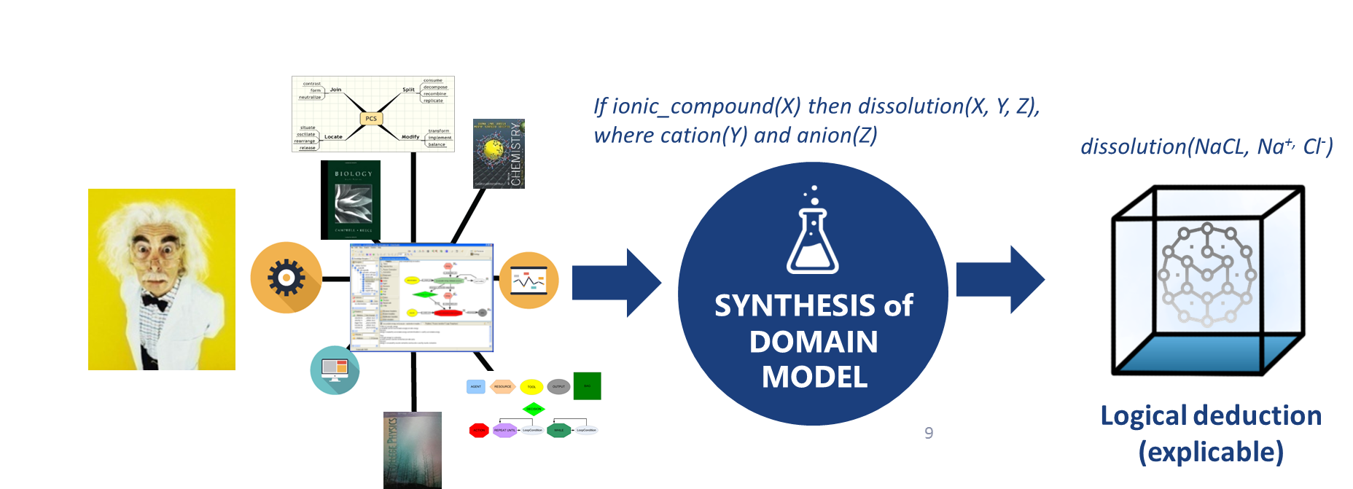

The knowledge-based approach
“Project Halo aims to create an artificial intelligence able to answer novel questions in scientific domains with expertise equivalent to Advanced Placement competence level”
The Halo approach was based on a structured knowledge representation that supports reasoning and logical explanations
Evaluated on a MCQ corpus in three scientific domains (Chemistry, Biology, Physics)

Slide 9
No other system EVER before achieved this performance with SME-entered knowledge
Knowledge Formulation
Question Formulation
Domain | Number of questions | Percentage correct
 |  | SME1 | SME2 | Avg | KE
Bio | 146 | 52% | 24% | 38% | 51%
Chem | 86 | 42% | 33% | 37% | 40%
Phy | 131 | 16% | 22% | 19% | 21%
Time for KF
Concept: ~20 mins for all SMEs
Equation: ~70 s (Chem) to ~120 sec (Physics)
Table: ~10 mins (Chem)
Reaction: ~3 mins (Chem)
Constraint: 14s Bio; 88s (Chem)
SME need for help
68 requests over 480 person hours
Avg. time for SME to formulate a question
2 min (Bio)
4 min (Chem)
6 min (Physics)
Usability
SMEs requested no significant help
Pipelined errors dominated failure analysis
Science grad student KBs
~$100 per syllabus page (vs. $1,000)
System Responsiveness
Bio: 90% answer < 10s
Chem: 60% answer < 10s
Phys: 45% answer < 10 s
Syllabus
Chemistry: Stoichiometry, solutions and equilibrium (Brown & Lemay, pages 75-83, 113-133, and 613-653)
Biology: Cell and DNA structure and processes (Campbell and Reece, pages 112-124, 217-223, 239-245, 293-301, 304-311, and 317-319)
Physics: Kinematics and Dynamics (Serway and Faughn, chapters 2,3, and 4)
From Greaves, 2008

Slide 10
Nothing is perfect
PROS
CONS
Detailed, expressive models based on human rich understanding of the domain
Tools can enable user-entered knowledge and optimize cost
Underlying formalisms support logical explanations
Requires a considerable amount of well trained, centralized labor to manually encode knowledge
Lacks scalability with large corpora and still costly due to humans in the loop
Possibly brittle, hard to generalize, and prone to human bias
Notes:
What we learnt from Halo

Slide 11
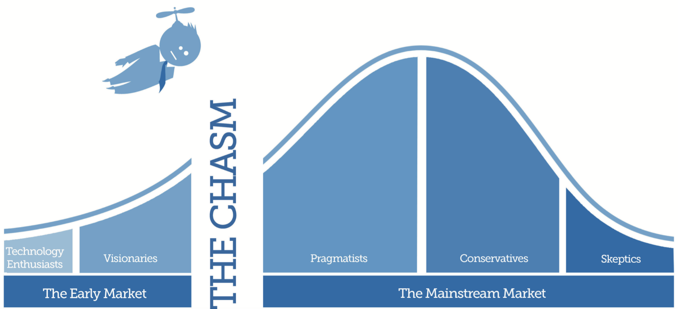
The Cognitive Chasm
How can humans and AI interact with and understand each other?
Machine understanding vs.
Human understanding
Is this possible or are they cognitively disconnected?
What mechanisms are needed to cross the cognitive chasm?
How can knowledge representation be both flexible, scalable, deep and logical?
Notes:
Several chams dimensions:
Approach: statistic ML vs. knowledge-based
Machine understanding vs. Human understanding
Until the chasm is addressed AI and their applications to LT will not effectively reach the mainstream market
How can humans and AI interact with and understand each other?
Is this possible or do they reason at levels of abstraction so different that they are cognitively disconnected?
What mechanisms are needed to cross the cognitive chasm?
How can AI explain their reasoning and be accountable?
How can AI have both highly expressive and flexible knowledge representation and reasoning schemes? Is this even possible?

Slide 12
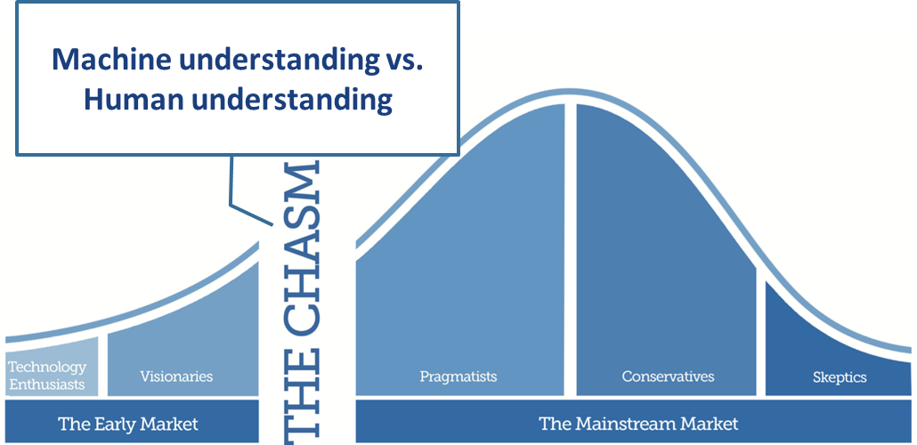
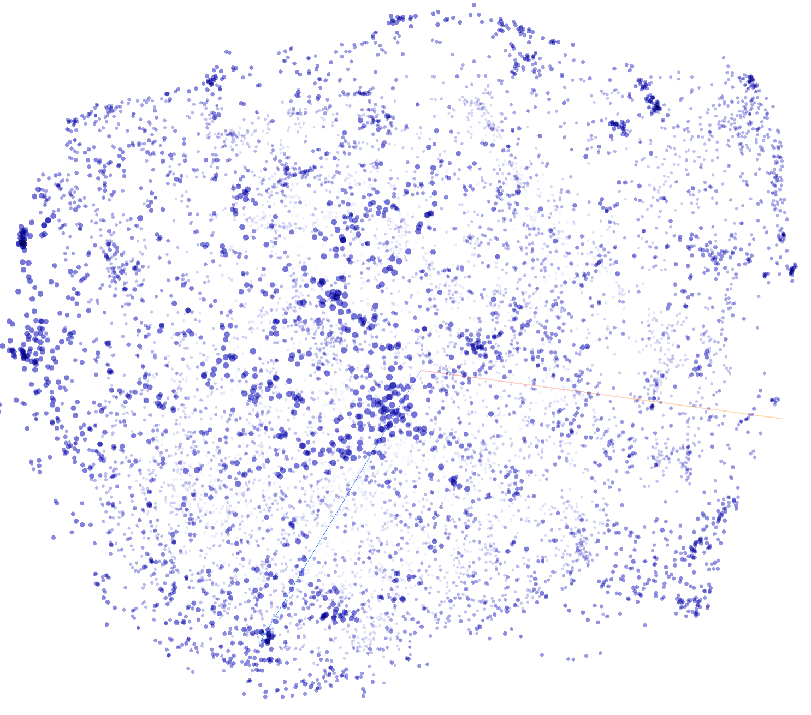


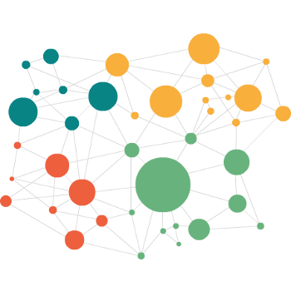

Our Hybrid approach to NLP
Knowledge encoded in the mind of the expert
Structured knowledge base
Good for logical deduction and explanation
Deep, but possibly rigid and brittle
Human is a bottleneck: hand-engineered features and powerful modeling tools needed
Knowledge embedded in corpora
Broad, flexible, scalable
Good for POS tagging, parsing, semantic relatedness
Statistic induction, not logical explanation
Lack of true understanding of real-world semantics and pragmatics
Brittleness (curated training corpora)
Vecsigrafo
Automatically learning how language is used in real life through large corpora and structured knowledge graphs
Denaux, R and Gómez-Pérez, JM (2018). Vecsigrafo: Corpus-based Word-Concept Embeddings - Bridging the Statistic-Symbolic Representational Gap in Natural Language Processing. Semantic Web Journal (under evaluation) http://www.semantic-web-journal.net/content/vecsigrafo-corpus-based-word-concept-embeddings-bridging-statisticsymbolic-representational
Notes:
We have seen limitations on both sides of the spectrum. Statistical ML and purely knowledge-based approaches. We aim at dealing with them through hybrid approaches based on the notion of natural learning, where we try to expand existing knowledge graphs with a representation of the domain knowledge that actually comes from human text.
Denaux, R and Gómez-Pérez, JM (2018). Vecsigrafo: Corpus-based Word-Concept Embeddings - Bridging the Statistic-Symbolic Representational Gap in Natural Language Processing. Semantic Web Journal (under evaluation) http://www.semantic-web-journal.net/content/vecsigrafo-corpus-based-word-concept-embeddings-bridging-statisticsymbolic-representational

Slide 13
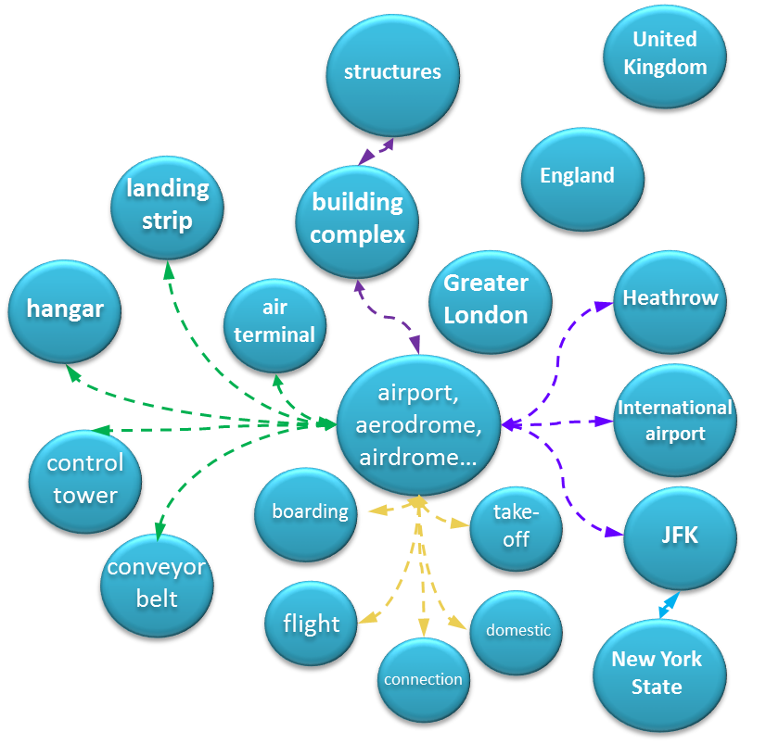
Natural language text is read and analyzed
Building blocks: COGITO ©
Natural language text is read and analyzed
1
Sentence splitting / parsing
Divide text into words
2
Morphological analysis
COGITO is a knowledge-based NLP system built on a KG called Sensigrafo, with word definitions, related concepts and linguistic information
Word-sense disambiguation, based on word context over Sensigrafo. Other basic NLP tasks include categorization and extraction
Main entities include syncons, (concepts), lemmas (canonical representation of a word) and relations (properties, hypernymy, polysemy, synonymy…)
~300K syncons, ~400K lemmas and 80+ relation types (~2.8 million links)
Your vecisgrafo can also use other combos of disambiguator and KG, e.g. shallow connectivity disambiguation and WordNet, DBpedia, etc.
Understand word forms (e.g. Verb conjugations)
3
Sentence / logical / grammatical analysis
Understand how words relate to other words, and what their function is in the sentence
4
Semantics analysis / disambiguation
Understanding sentences and texts as a whole, taking into account words synonyms, context, plausibility
...and then translated into a conceptual map
And then translated into a cognitive or conceptual map

Slide 14
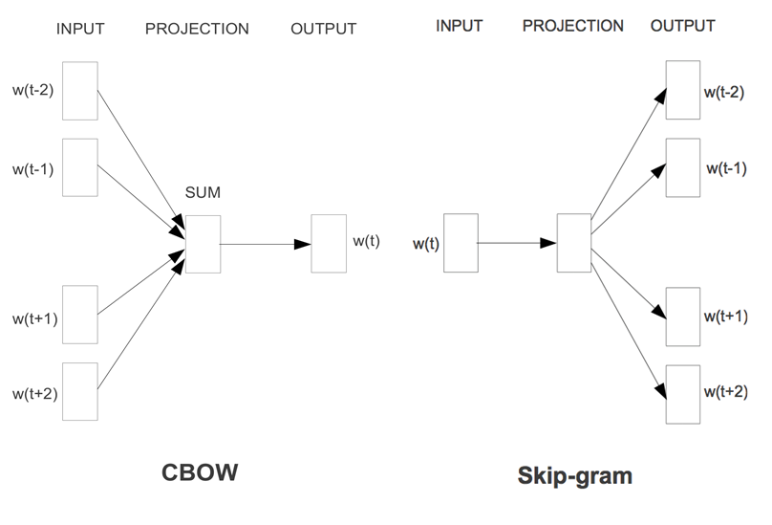
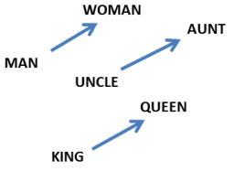
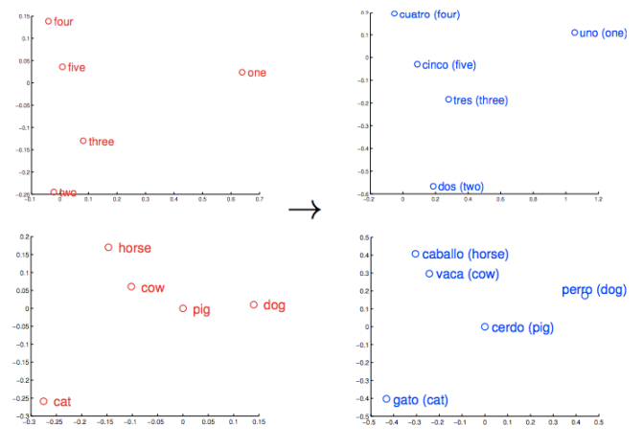
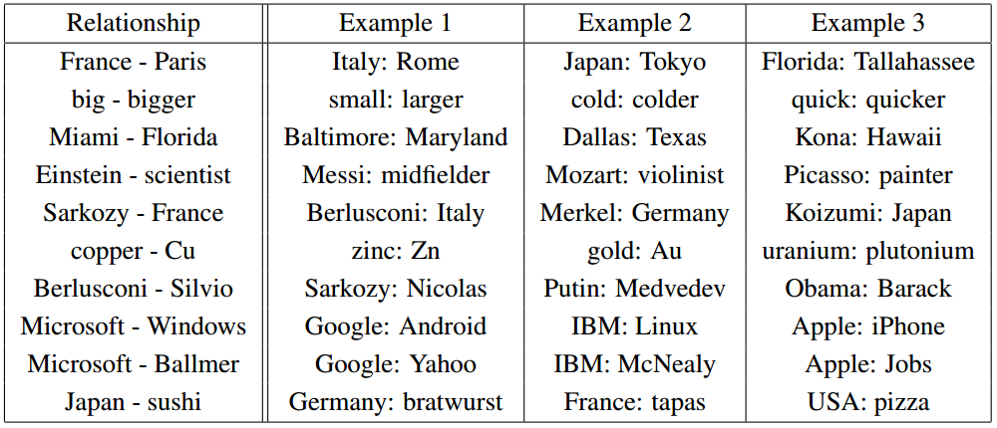
Building blocks: (not only) word embeddings
Provide a compact representation of words in a vector space, capturing their meaning as per document corpora
Enable word similarity, analogy and relatedness based on vector arithmetic
Semantic portability over languages
Notes:
Second piece (building a language model): Word2Vec
Not only words!

Slide 15
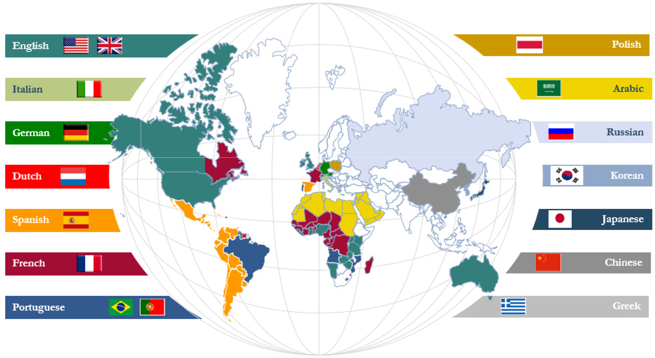
Made in the Lab, born from business needs
Map individual KGs
Correlate, curate, co-develop across multiple KGs
Cross-lingual, cross-modal
Assisted KG validation and refinement
Fast internationalization at Expert System (EU, US, LATAM) and growing customer needs in 14 languages
Need to quickly reuse and leverage semantic resources from strongly represented languages into less represented languages

Slide 16
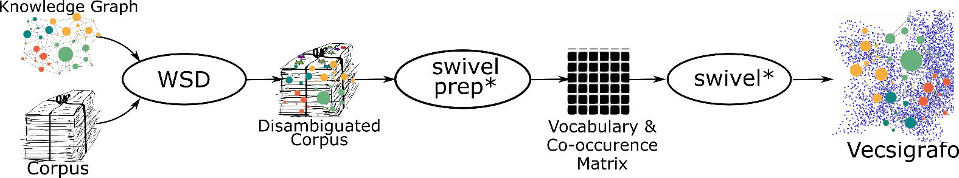
What you will find in this tutorial
What a vecsigrafo is (and what it is not) and how to build one using Sensigrafo or other KGs

Slide 17
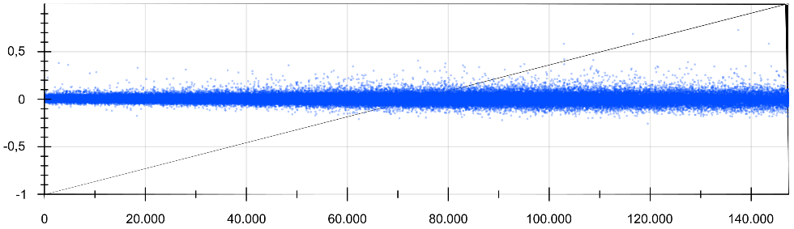
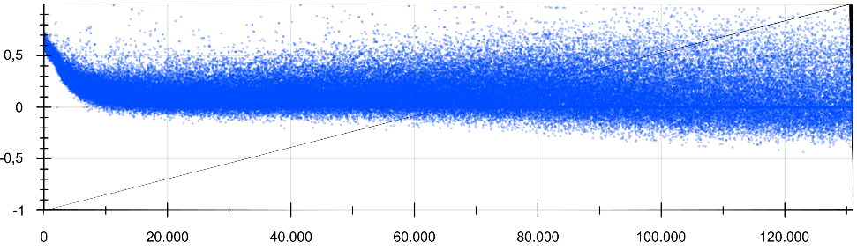
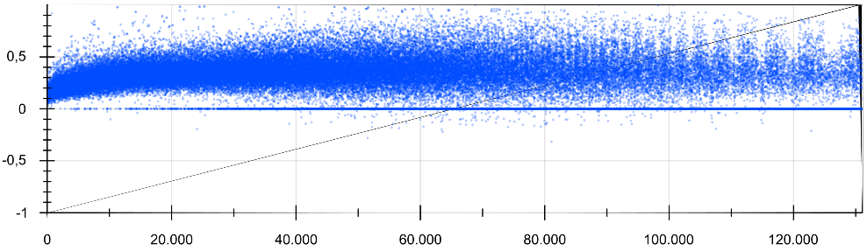
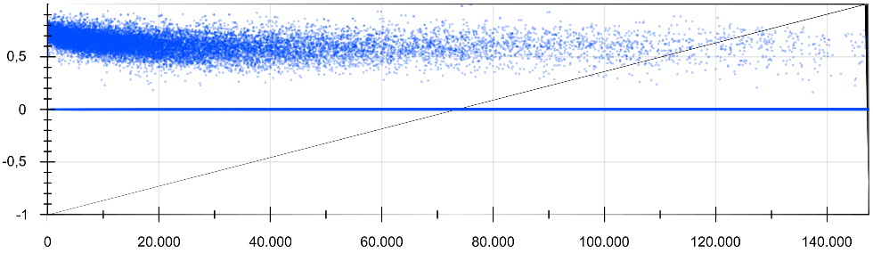
What you will find in this tutorial
How to evaluate the quality of a vecsigrafo (and in general word and concept embeddings) beyond the usual word similarity benchmarks
Word Prediction Plots
(quality validation and hypothesis checking)
a) Random baseline
b) Buggy correlations
c) Uncentered
d) Re-centered

Slide 18
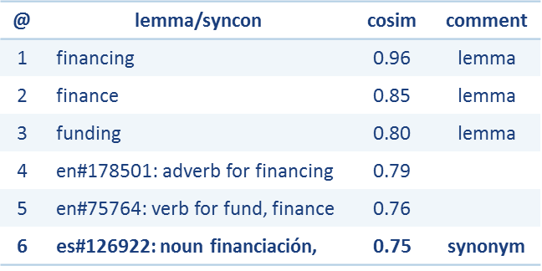

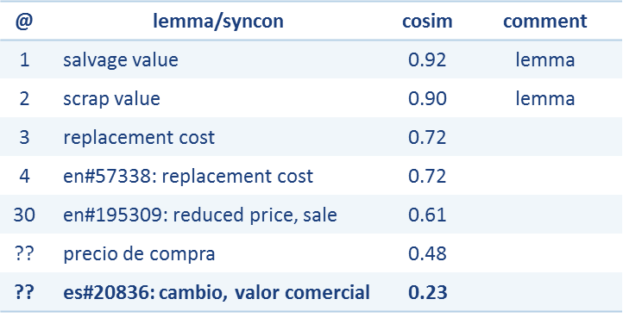

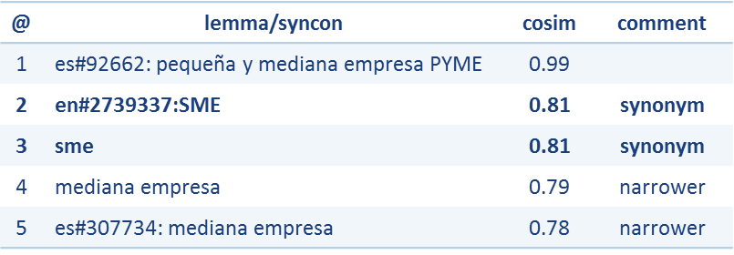
What you will find in this tutorial
“Financing” (EN→ES)
How to use vecsigrafos to curate and interlink KGs, e.g. in cross-lingual domains
“Scrap value” (EN→ES)
“PYME” (ES→EN)

Slide 19
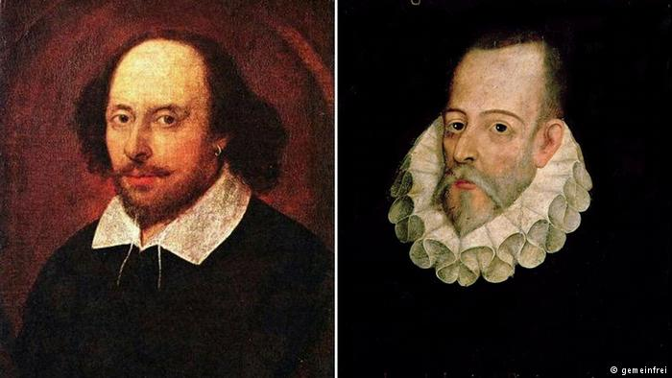

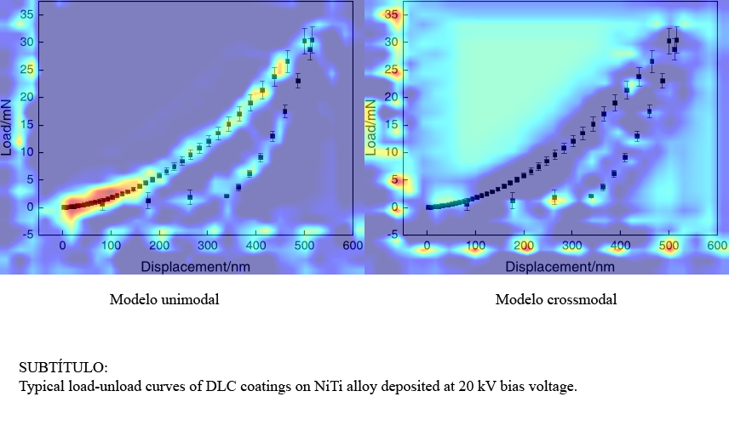
What you will find in this tutorial
Example applications and exercises in three domains: Classic literature, fake news detection and scientific information management
Different NLP tasks
Cross-linguality/modality

Slide 20
Hybrid Techniques for Knowledge-based NLP (HybridNLP) - knowledge graphs meet machine learning and all their friends
Jose Manuel Gomez-Perez & Ronald Denaux {jmgomez,rdenaux}@expertsystem.com
This tutorial was possible also thanks to:
Andres Garcia
Raul Ortega
Olga Salas
Daniel Anton
We gratefully acknowledge projects EVER-EST, DANTE, TRIVALENT and GRESLADIX

Slide 21
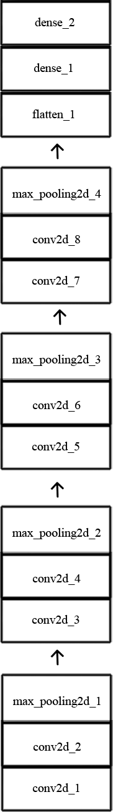
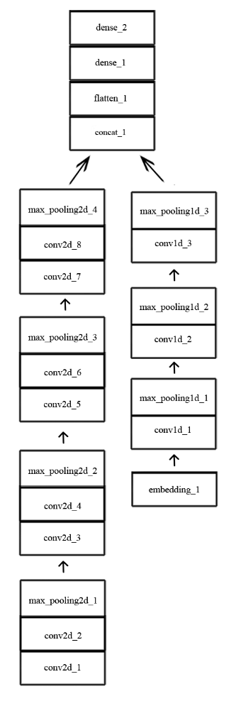
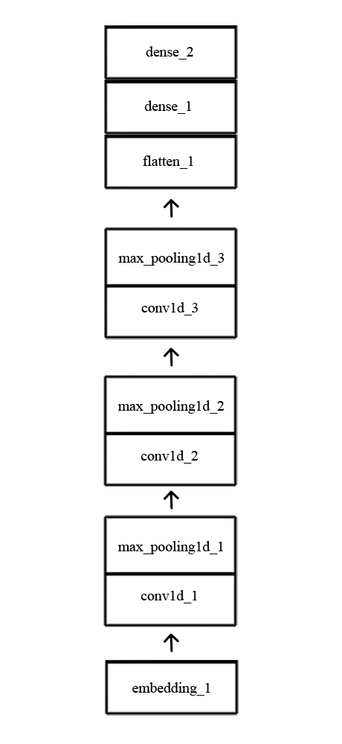
Approach and preliminary results
TEXTUAL
VISUAL
HYBRID
Figure-caption association (F1-score): 0.75
Textual classification
Category | Precision |  | Recall |  | F1-Score
 | Textual | Hybrid | Textual | Hybrid | Textual | Hybrid
Health | 88.6% | 87.8% | 86.8% | 87.3% | 0.877 | 0.875
Engineering | 77.7% | 77.0% | 76.9% | 75.8% | 0.771 | 0.763
Biology | 59.7% | 66.7% | 60.4% | 54.2% | 0.597 | 0.588
Math | 68.1% | 71.5% | 76.2% | 71.2% | 0.719 | 0.713
IT | 71.1% | 65.0% | 64.2% | 70.7% | 0.672 | 0.674
Visual classification
Category | Precision |  | Recall |  | F1-Score
 | Visual | Hybrid | Visual | Hybrid | Visual | Hybrid
Health | 74.3% | 75.6% | 88.3% | 87.6% | 0.81 | 0.813
Engineering | 49.0% | 53.0% | 49.3% | 46.3% | 0.483 | 0.49
Biology | 28.3% | 33.6% | 6.0% | 6.6% | 0.10 | 0.11
Math | 56.6% | 54.6% | 61.3% | 68.0% | 0.58 | 0.6
IT | 48.6% | 49.3% | 36.6% | 39.6% | 0.413 | 0.43
Based on Arandjelovic et al, 2017
Notes:
Precision = TP/(TP+FP)
Recall = TP/(TP+FN)
F1 = 2*PR/(P+R)
Based on Arandjelovic et al., 2017

Slide 22
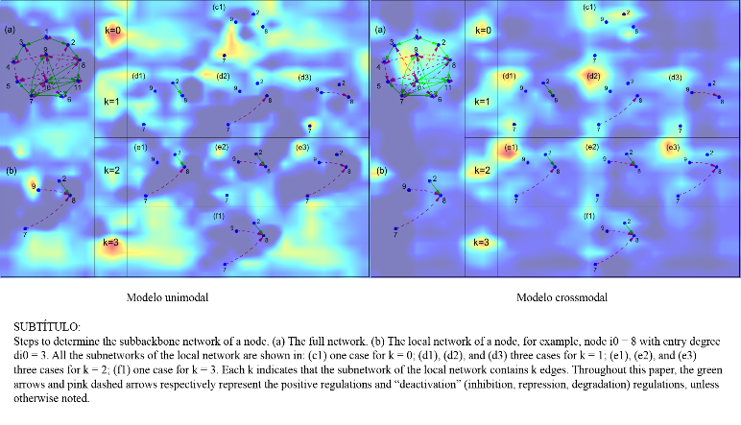
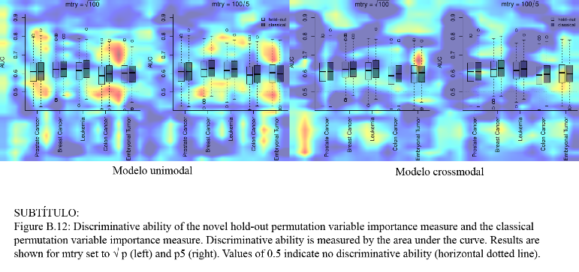
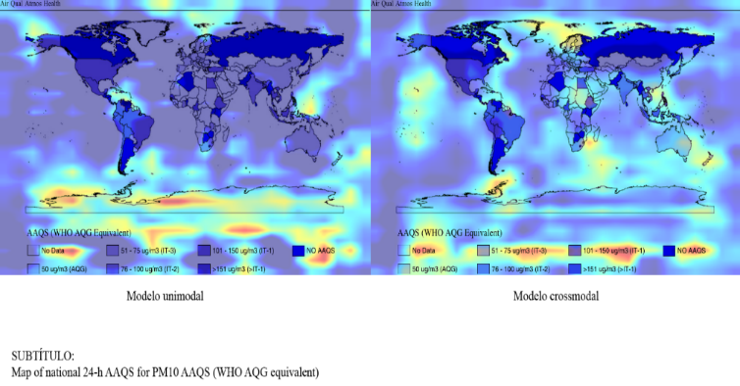
Some interesting qualitative findings
The hybrid model seems to identify textual parts in the figure more accurately

